Slide 1

Project Title
AI-Based Smart Transport Fleet Management System
SOA Project Review-2
22-09-2026
Team Members Name L. Suvarchala Mrudani Roll Number 2420030591 Name P.Hasitha Sai Keerthana Roll Number 2420090107 Name C.Suma Priya Varma Roll Number 2420030337
 | Under the Guidance of K.Venkateshwari Department of Computer Science and Engineering, KLH CSE Bowrampet Campus

Slide 2

Outline of Project Work
Focus
Introduction
Literature Survey
Challenges
Research Objectives
Conclusion & Future Work
References
Publications Details

Slide 3
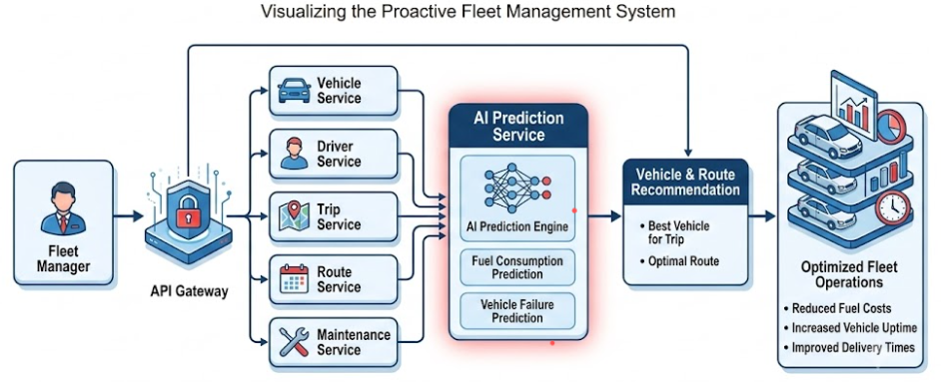
Problem Statement
Traditional fleet management systems mainly depend on manual decision-making and reactive management.
Unexpected vehicle breakdowns can lead to vehicle downtime and increased maintenance costs.
Inefficient vehicle allocation can result in poor fleet utilization and underutilization of available vehicles.
High and unpredictable fuel consumption can increase overall transportation and operational costs.
Inefficient route and trip planning can result in longer travel times and unnecessary fuel usage.
Existing systems often manage vehicles, drivers, trips, fuel, and maintenance separately, limiting integrated decision-making.
There is a need for an AI-powered SOA-based system that predicts risks and recommends efficient fleet decisions proactively.

Slide 4
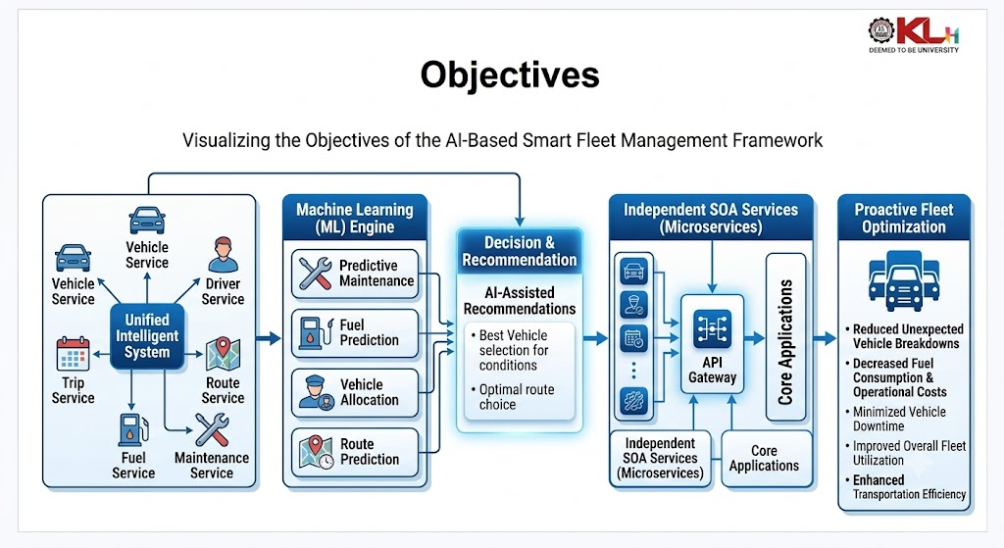
Objectives
To improve fleet management efficiency by integrating vehicle, driver, trip, route, fuel, and maintenance information through a unified intelligent system.
To leverage Machine Learning techniques for predictive maintenance, fuel-consumption prediction, vehicle allocation, and travel-time/route prediction.
To enhance the existing system, we propose an AI-Based Smart Fleet Management Framework that integrates independent SOA-based services for intelligent and scalable fleet operations.
To provide AI-assisted recommendations for selecting the most suitable vehicle and route based on vehicle condition, availability, fuel efficiency, maintenance risk, and trip requirements.
To develop an SOA-based modular architecture in which vehicle, driver, trip, maintenance, route, and AI services communicate through APIs and can be independently developed, deployed, and scaled.
To reduce unexpected vehicle breakdowns, fuel consumption, operational costs, and vehicle downtime through predictive and data-driven decision-making.
To improve overall fleet utilization and transportation efficiency by enabling proactive planning and intelligent fleet optimization.

Slide 5
Literature Survey
Authors | Title of the Paper | Methodology | Inferences | Limitation/Future work
Theissler et al. (2021) | Predictive maintenance enabled by machine learning: Use cases and challenges in the automotive industry | ML-based predictive maintenance; supervised and deep-learning approaches | ML can use vehicle operating data to predict maintenance needs and support vehicle reliability. | Requires sufficient labelled data; combining multiple data sources and improving interpretability remain challenges.
Monnerat et al. (2019) | Fleet management: A vehicle and driver assignment model | Generalized Assignment Problem; mathematical optimization and genetic-algorithm-based matheuristic | Joint vehicle-driver assignment can optimize planned trips and reduce operational costs. | Larger fleet-assignment problems become computationally challenging; heuristic approaches are needed for scalability.
Ko (2022) | Machine Learning Methods to Predict Vehicle Fuel Consumption | Linear Regression, KNN, Decision Tree, Random Forest, Gradient Boosting | Vehicle speed, acceleration and road gradient can be used as features for ML-based fuel-consumption prediction. | Prediction depends on driving and road conditions; broader real-world datasets can improve applicability.
Giannoulidis & Gounaris (2023) | A context-aware unsupervised predictive maintenance solution for fleet management | Unsupervised streaming anomaly detection; proximity-based, statistical and transformer methods | Context-aware anomaly detection can support predictive maintenance in vehicle fleet environments. | Detecting failures in advance remains challenging; wider data availability and real-world validation can improve robustness.

Slide 6
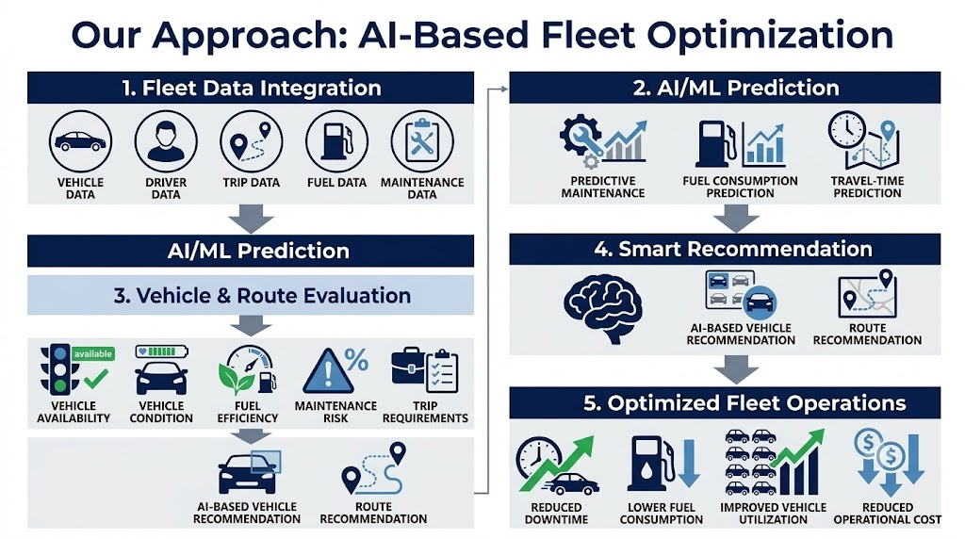
Problem Gap Identification
Problem Gap Identification
Existing approaches
Primarily focus on vehicle tracking, trip scheduling, and record management.
Fleet decisions often depend on manual and reactive decision-making.
Maintenance is generally performed after faults or breakdowns occur.
Vehicle allocation may not jointly consider availability, condition, fuel efficiency, and maintenance risk.
Fuel monitoring and route planning are often handled independently.
Monolithic systems can make scaling, integration, and maintenance difficult.
Ambiguity in communication which can be overcome using AI integrated chatbots
Identified Gap
There is a need for an integrated intelligent fleet-management system that combines:
AI/ML Prediction + Predictive Maintenance + Fuel Prediction + Vehicle Allocation + Route/Travel-Time Prediction + SOA Architecture+AI chatbot

Slide 7
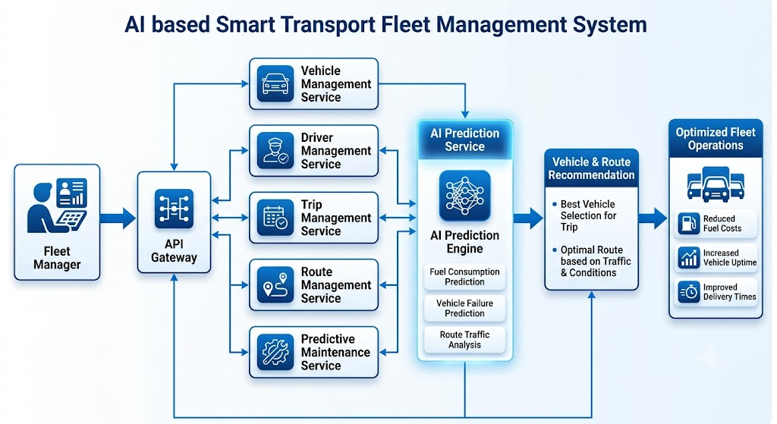
Innovation, Creativity, and Novelty
1. AI-Based Vehicle Allocation
The system recommends the most suitable vehicle for each trip by considering:
Vehicle availability
Vehicle condition
Fuel efficiency
Maintenance risk
Trip requirements
2. Predictive Fleet Intelligence
Machine Learning predicts important fleet parameters such as:
Maintenance requirements
Fuel consumption
Travel time
Route efficiency
3. Integrated SOA-Based Fleet Optimization
Instead of managing fleet operations separately, the system integrates vehicle, driver, trip, route, maintenance, and AI services through APIs to provide intelligent and scalable fleet-management decisions.

Slide 8
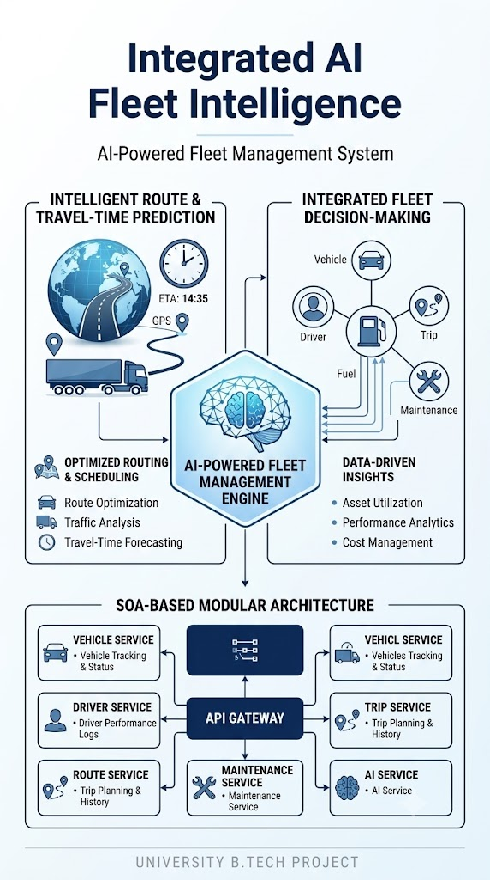
4. Intelligent Route & Travel-Time Prediction
Uses historical and operational data to predict travel time and recommend efficient routes for planned trips.
5. Integrated Fleet Decision-Making
Combines vehicle, driver, trip, maintenance, fuel, and route information to provide data-driven fleet management decisions.
6. SOA-Based Modular Architecture
Implements independent services communicating through APIs, allowing vehicle, driver, trip, route, maintenance, and AI services to be developed, deployed, and scaled independently.

Slide 9
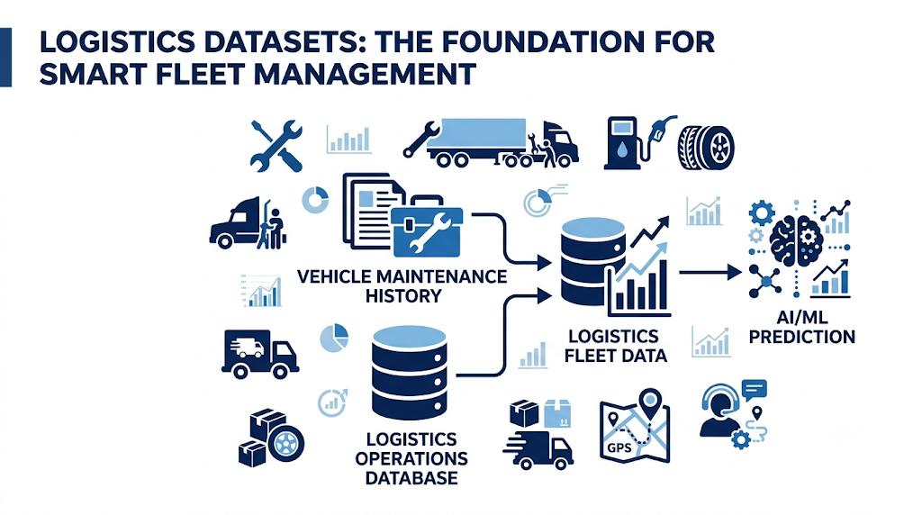
DataSets:
Logistics Vehicle Maintenance History Dataset :https://www.kaggle.com/datasets/datasetengineer/logistics-vehicle-maintenance-history-dataset
Used for predictive maintenance and identifying potential maintenance requirements from historical vehicle data.
Logistics Operations Database: https://www.kaggle.com/datasets/yogape/logistics-operations-database
Used for vehicle, driver, trip, and operational analysis to support intelligent vehicle allocation.
Logistics Operations Database
https://www.kaggle.com/datasets/kundanbedmutha/delivery-logistics-dataset-india-multi-partner
Used for analyzing delivery operations and supporting route and travel-time prediction.

Slide 10
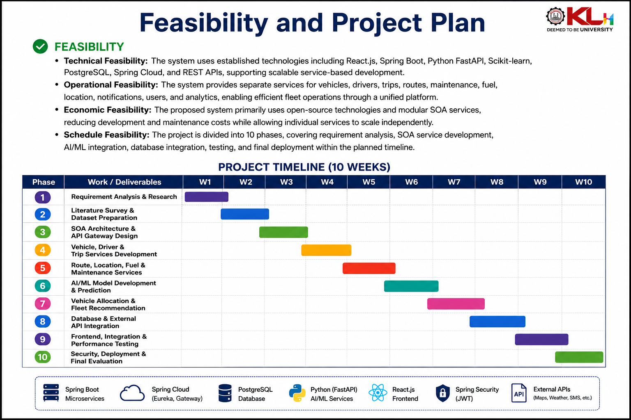
Feasibility and Project Plan
TIMELINE CHART FOR EACH PHASE OF YOUR PROJECT SHOULD BE THERE AFTER EXPLANATION

Slide 11
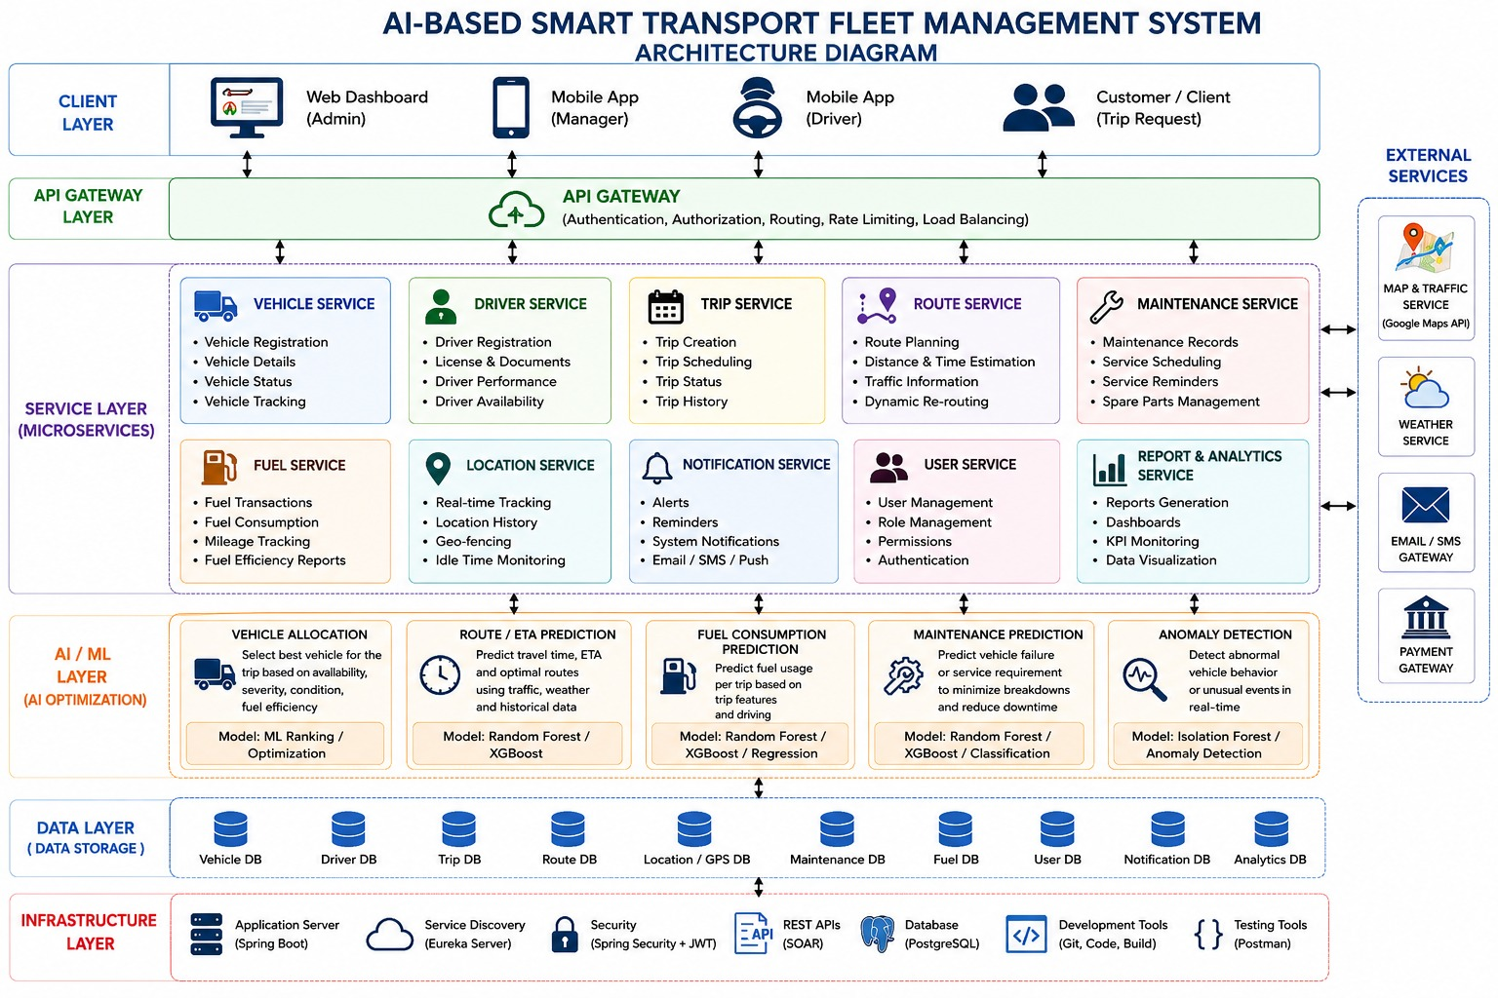

Slide 12
FrontEnd Implemetation
Developed a role-based web interface for Manager, Driver, and User.
Provides dashboards for vehicle, driver, trip, maintenance, fuel, and route information.
Integrates backend services through APIs following the SOA architecture.
Displays AI/ML predictions and vehicle-allocation recommendations.
Provides route and travel-time prediction results for planned trips.
Includes an AI chatbot for natural-language interaction and easier access to fleet information.
Designed with a modular structure so individual services can be integrated and updated independently.

Slide 13
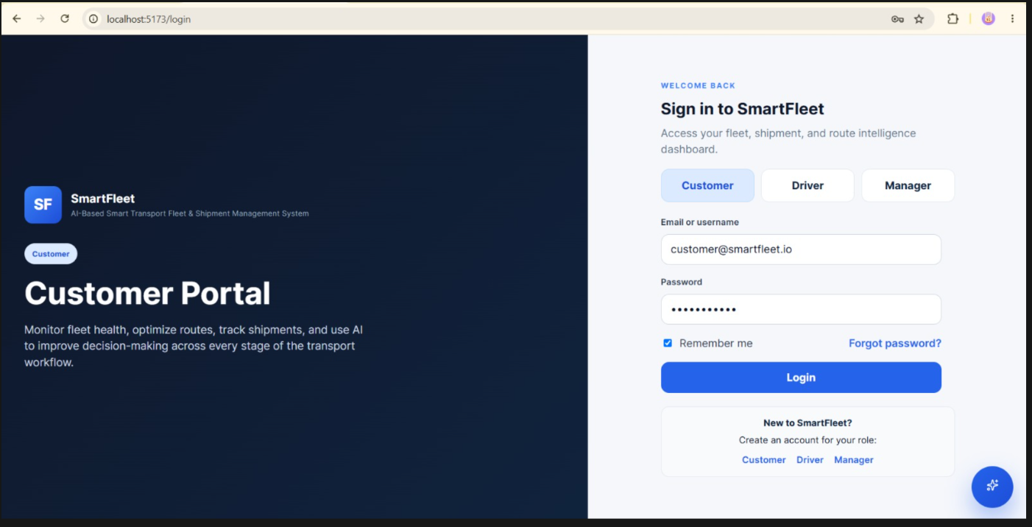
FrontEnd Implemetation

Slide 14
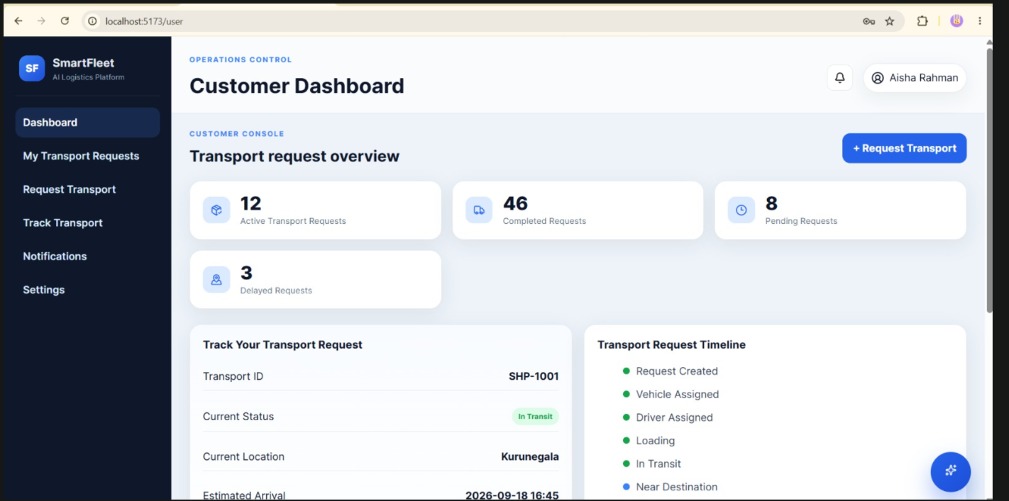
.

Slide 15
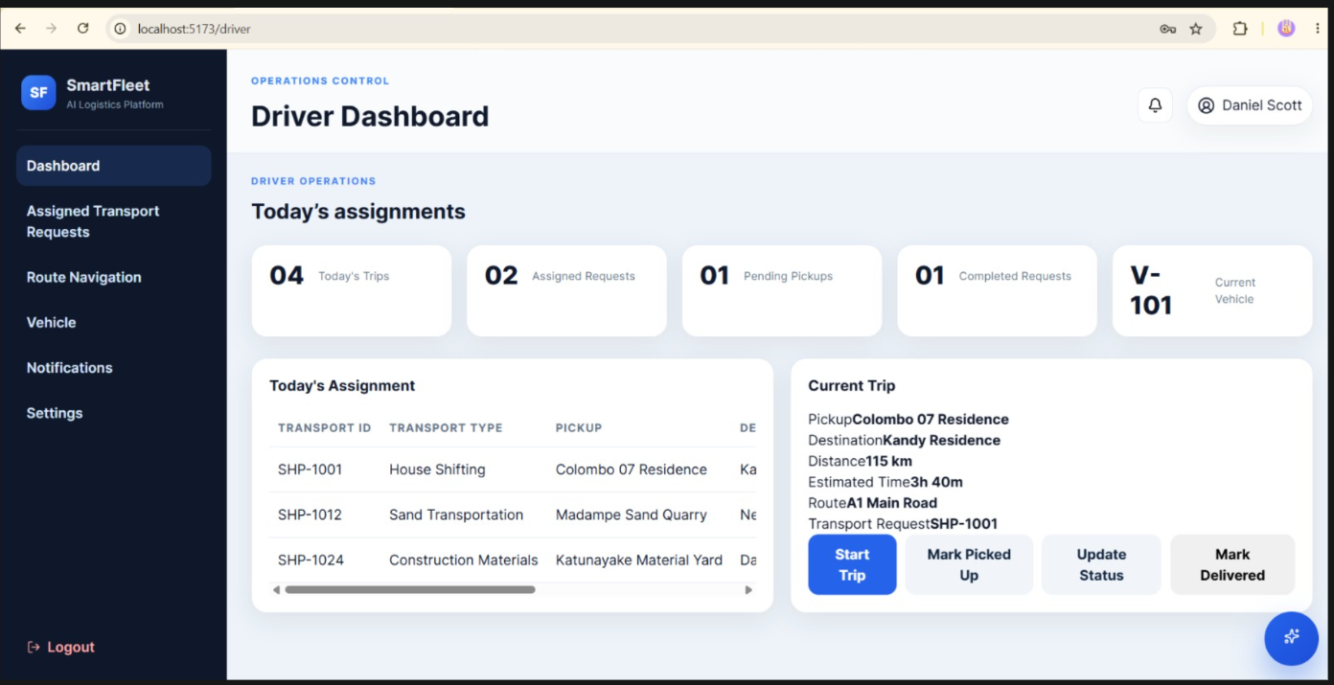
.

Slide 16
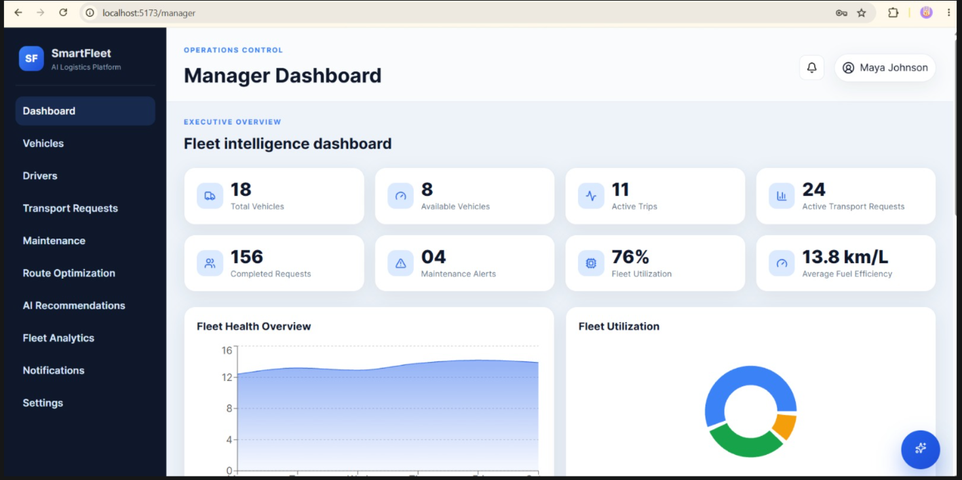
.

Slide 17
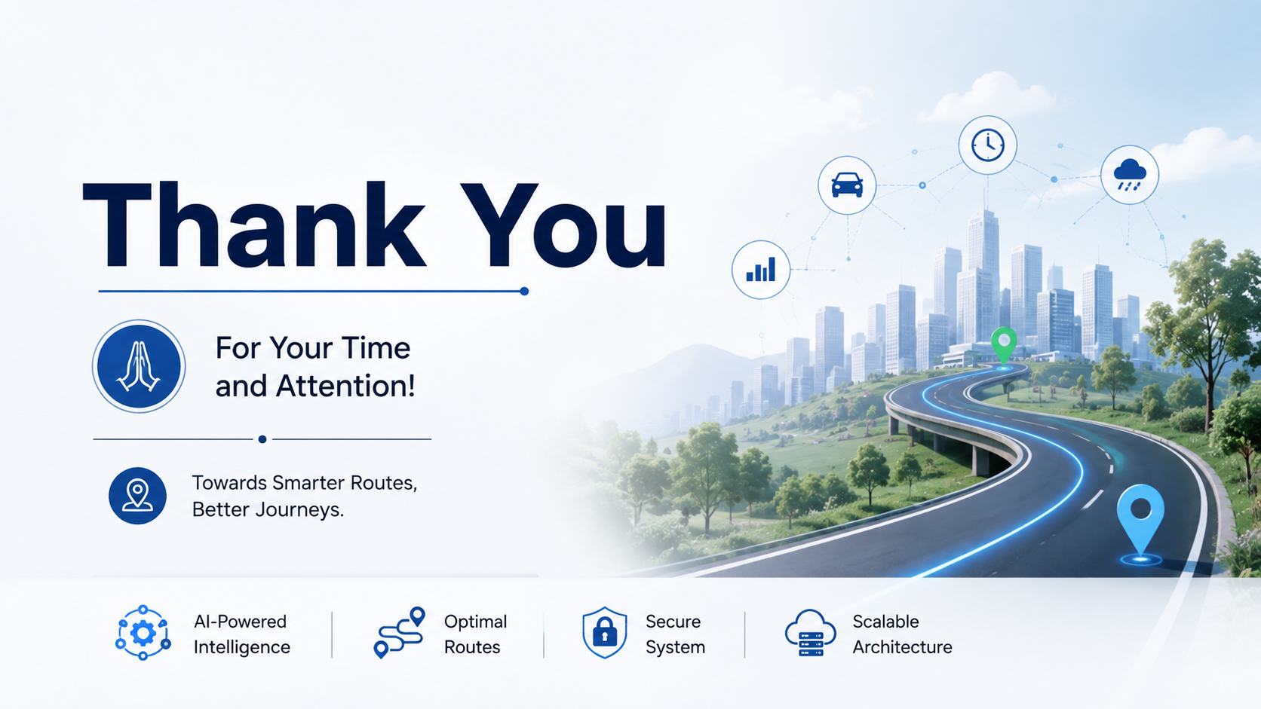
Thankyou

